Slide 1
Unit-IV Part-2
Planning and Learning with Tabular Methods

Slide 2
Outline of the Presentation( IV Part-2)
1. Introduction -Models and Planning
2. Integrating Planning, Acting and Learning
3. When the Model is Wrong
4. Prioritized Sweeping

Slide 3
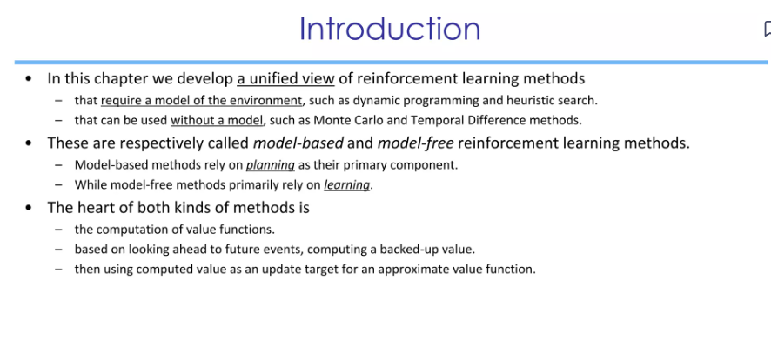
1.Introduction

Slide 4
1. Models and Planning
Model of the environment , we mean anything that an agent can use to predict how the environment will respond to its actions.
Distribution Model
Sample Model

Slide 5
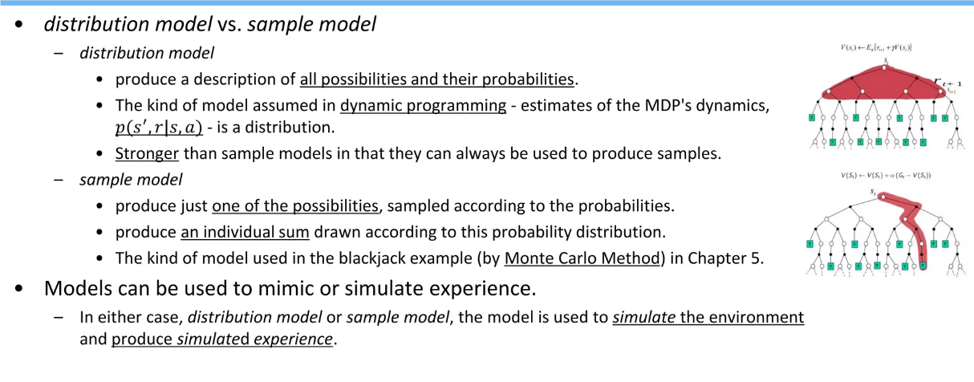
Models and Planning

Slide 6
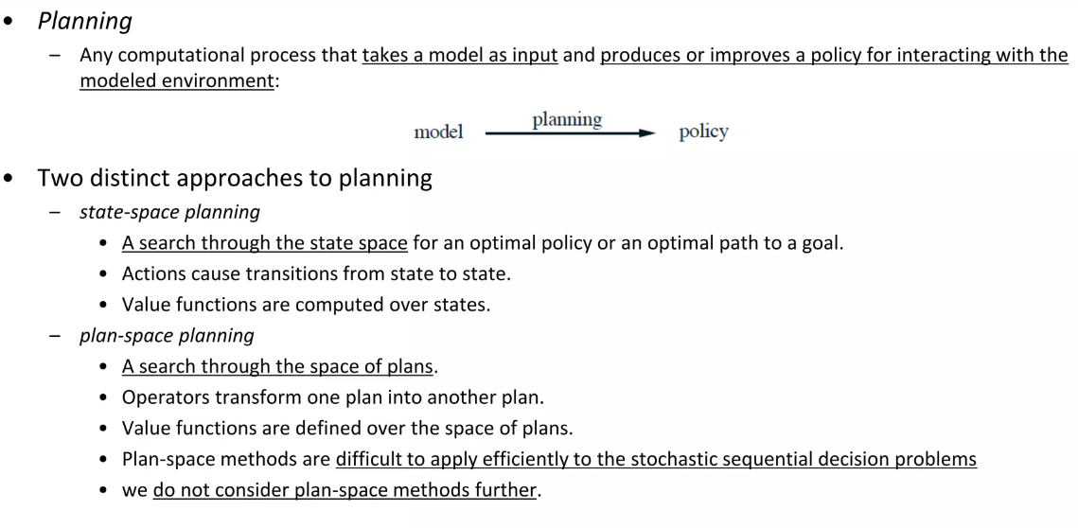

Slide 7
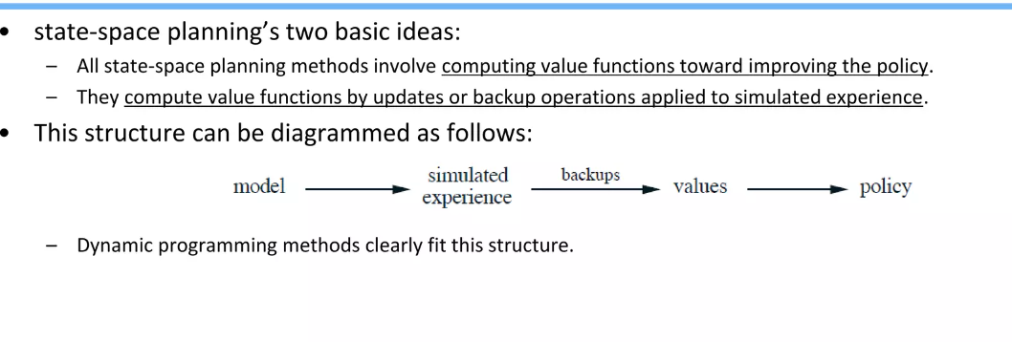

Slide 8
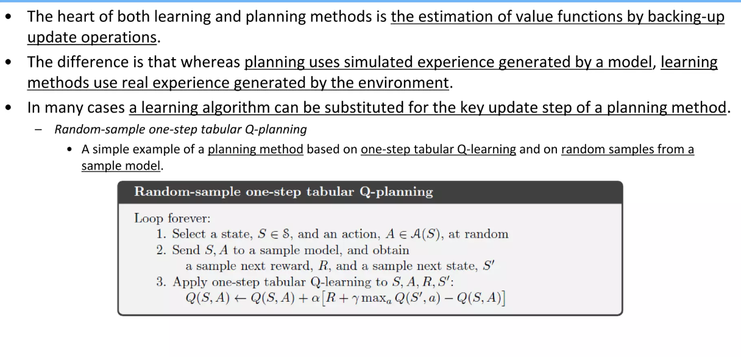

Slide 9
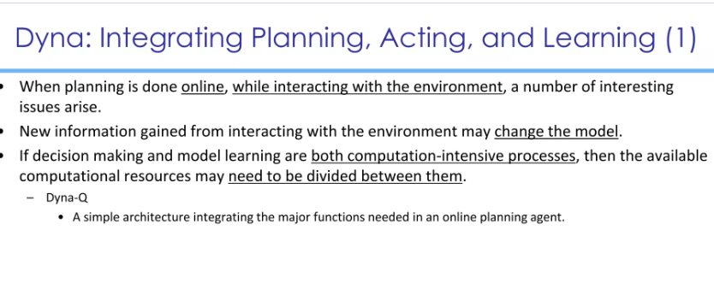
2.Integrating Planning, Acting and Learning

Slide 10
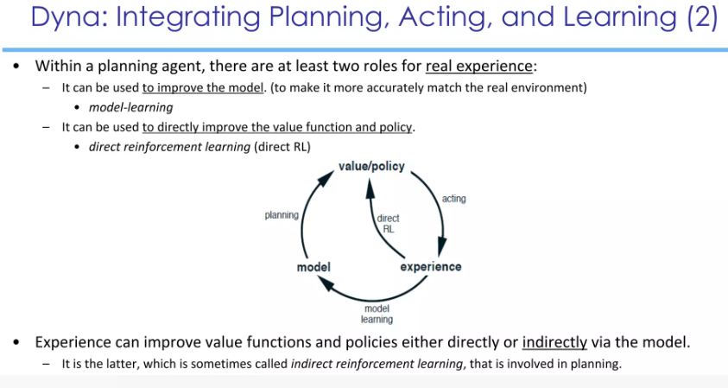

Slide 11
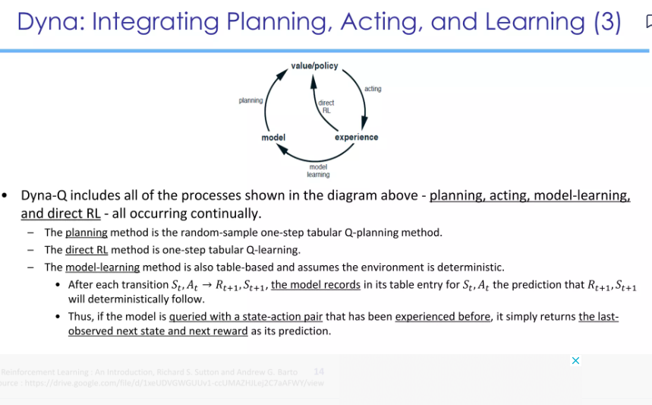

Slide 12
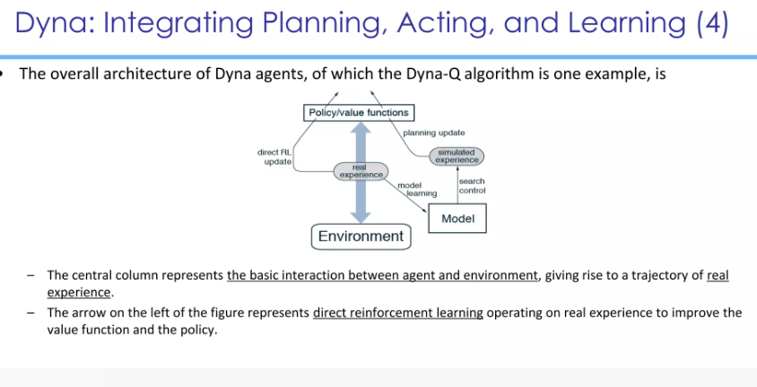

Slide 13
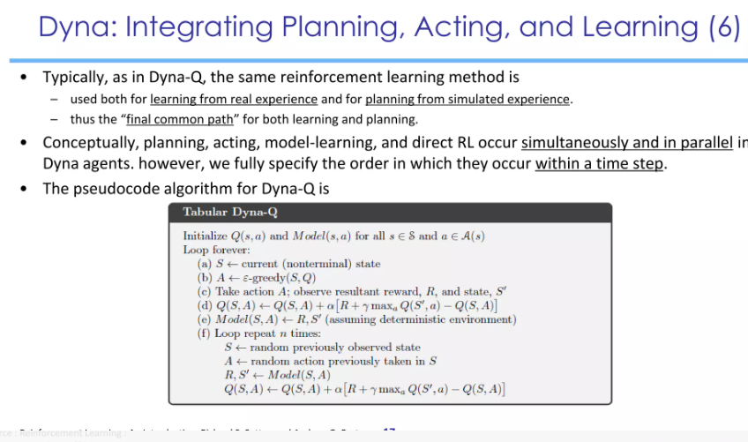

Slide 14
